Slide 1
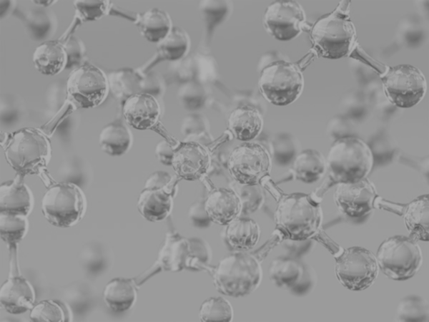


Week 7
2nd Level Transformations
Zachary Chang
University of California, Los Angeles (UCLA)
Contact: zachang890@g.ucla.edu
Physics of AmoRphous and
Inorganic Solids Laboratory

Slide 2
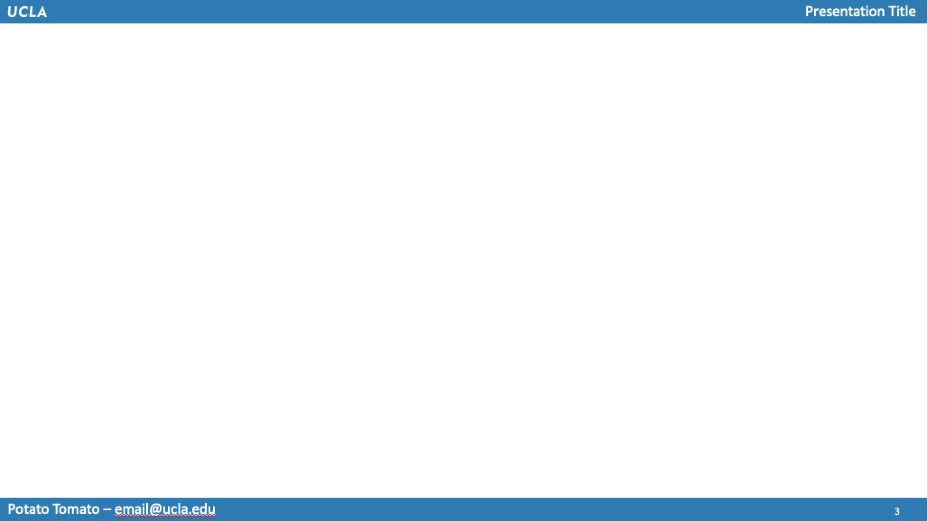

Work Completed
Organized all previous code into class and class methods to improve testing performance
Created archive of selected features for the model selection team
Initial steps into 2nd level feature transformations

Slide 3
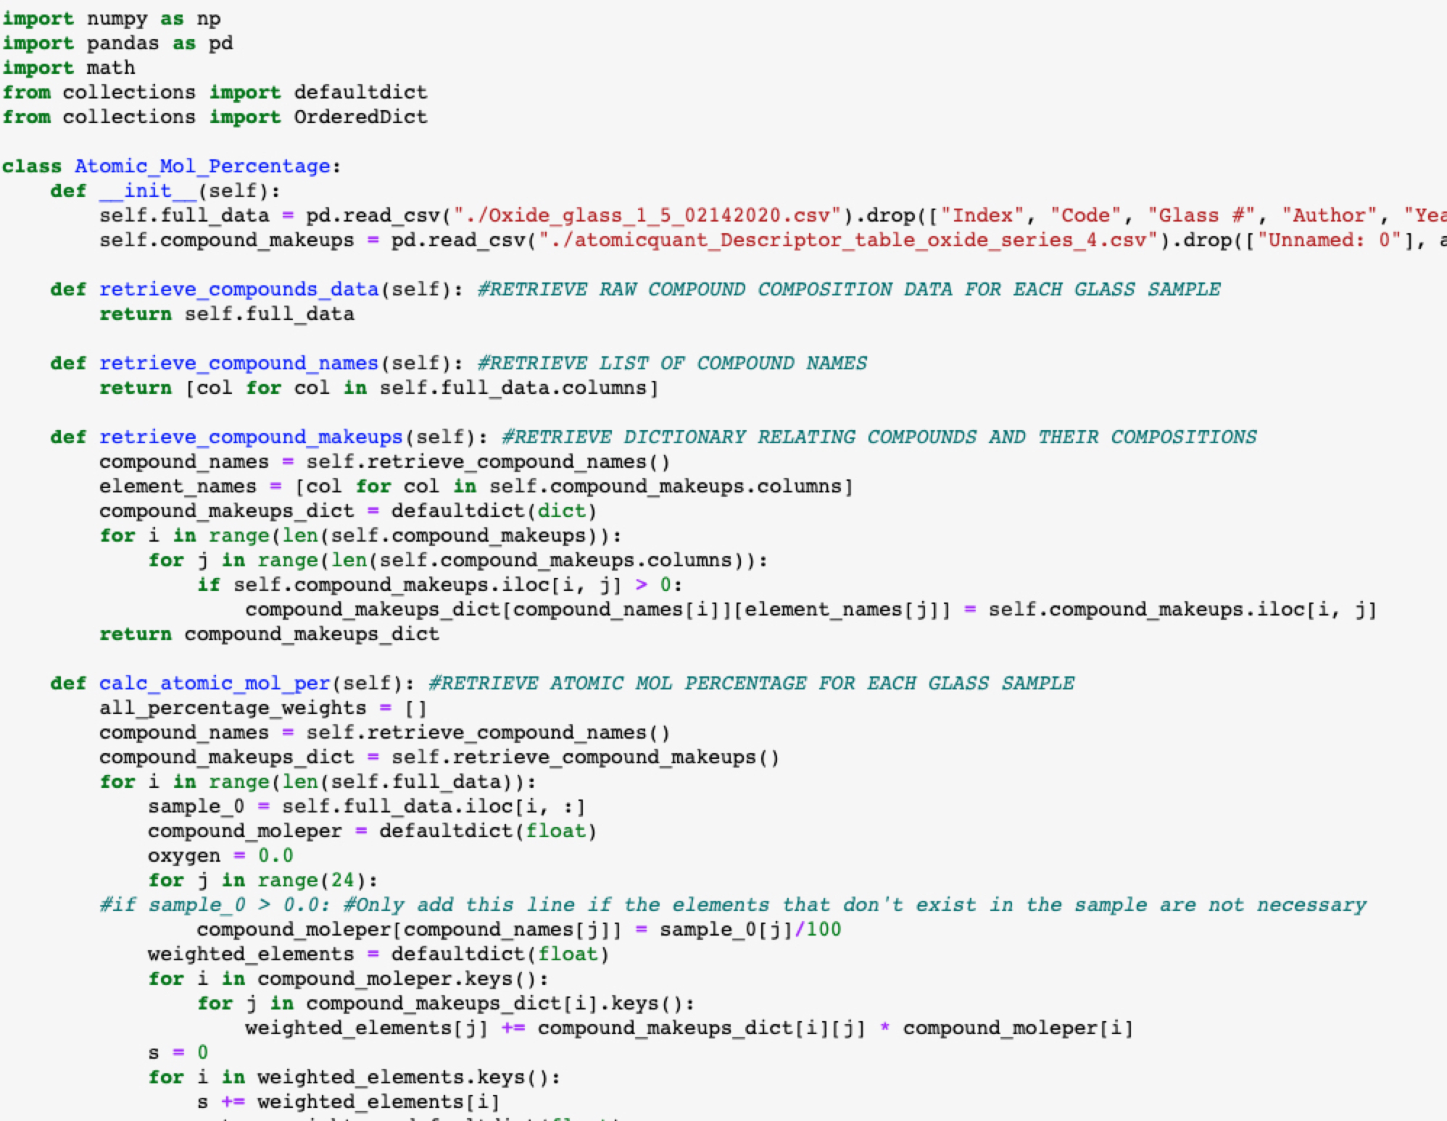
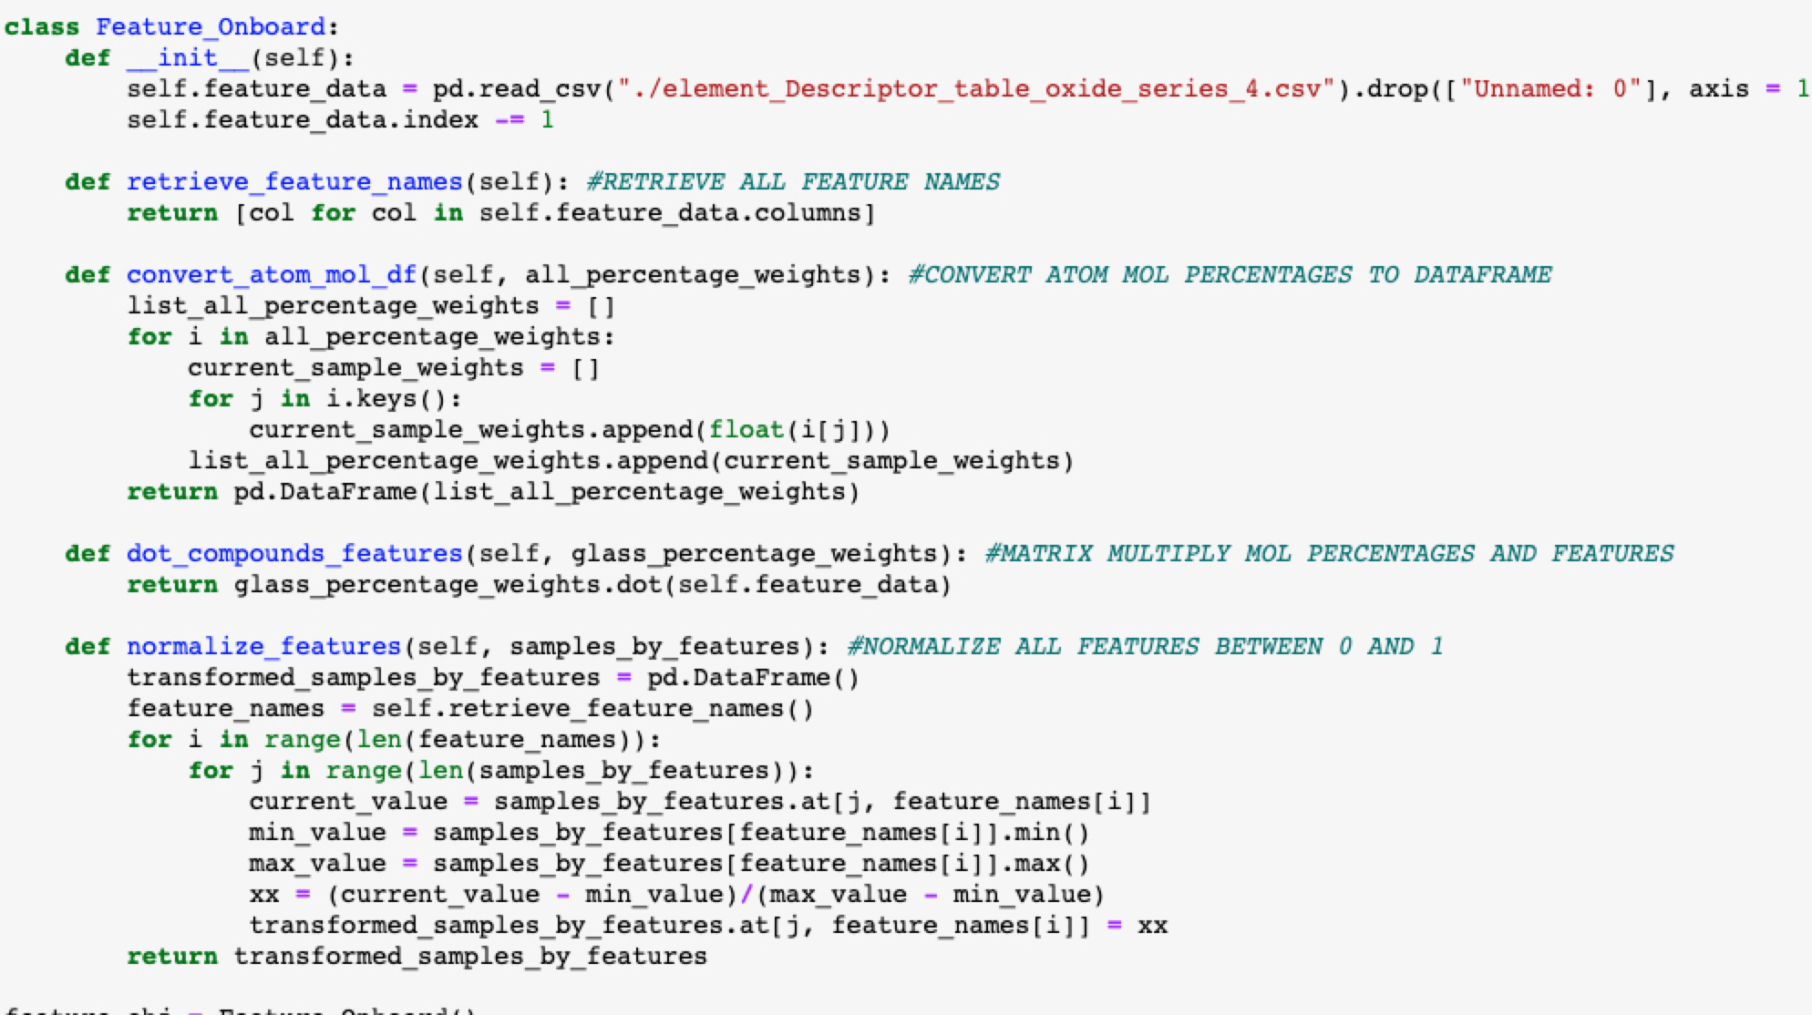
Code Organization
Excerpt from N x P matrix of atomic mol %
Class for feature onboarding and normalization
Class for calculating atomic mol percentage

Slide 4
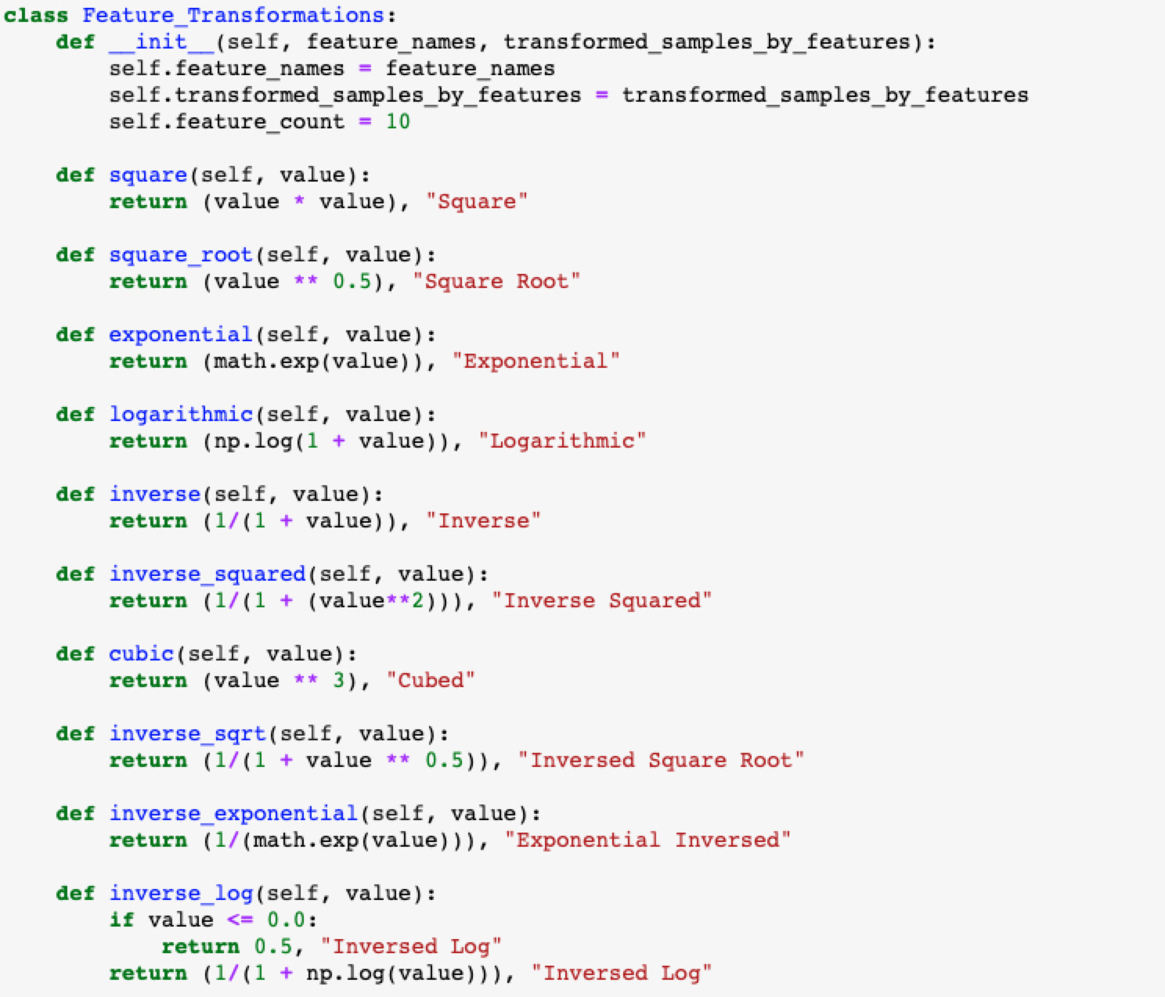
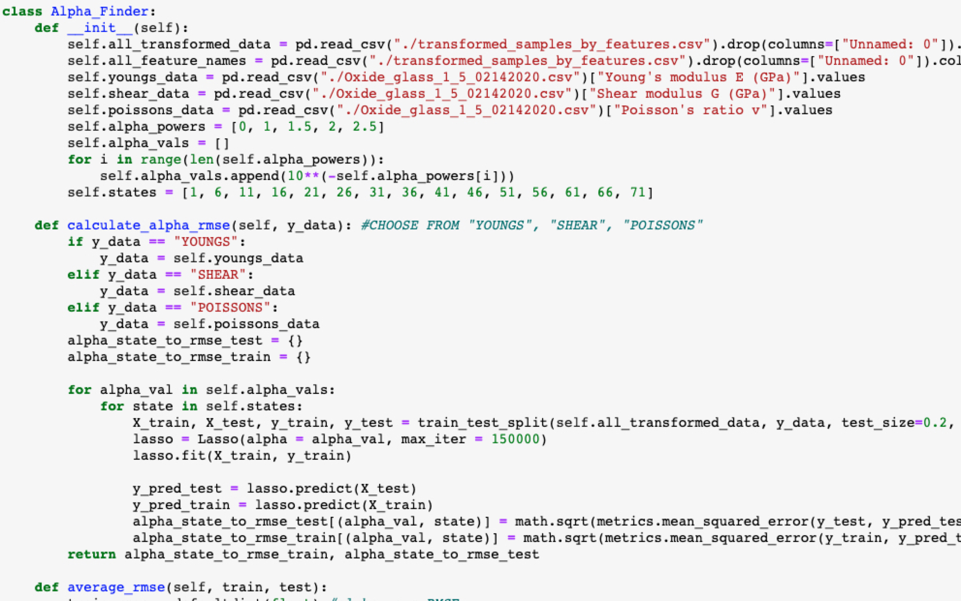
Code Organization (cont.)
Excerpt from N x P matrix of atomic mol %
Class for alpha selection and feature selection
Class for mathematical transformations

Slide 5
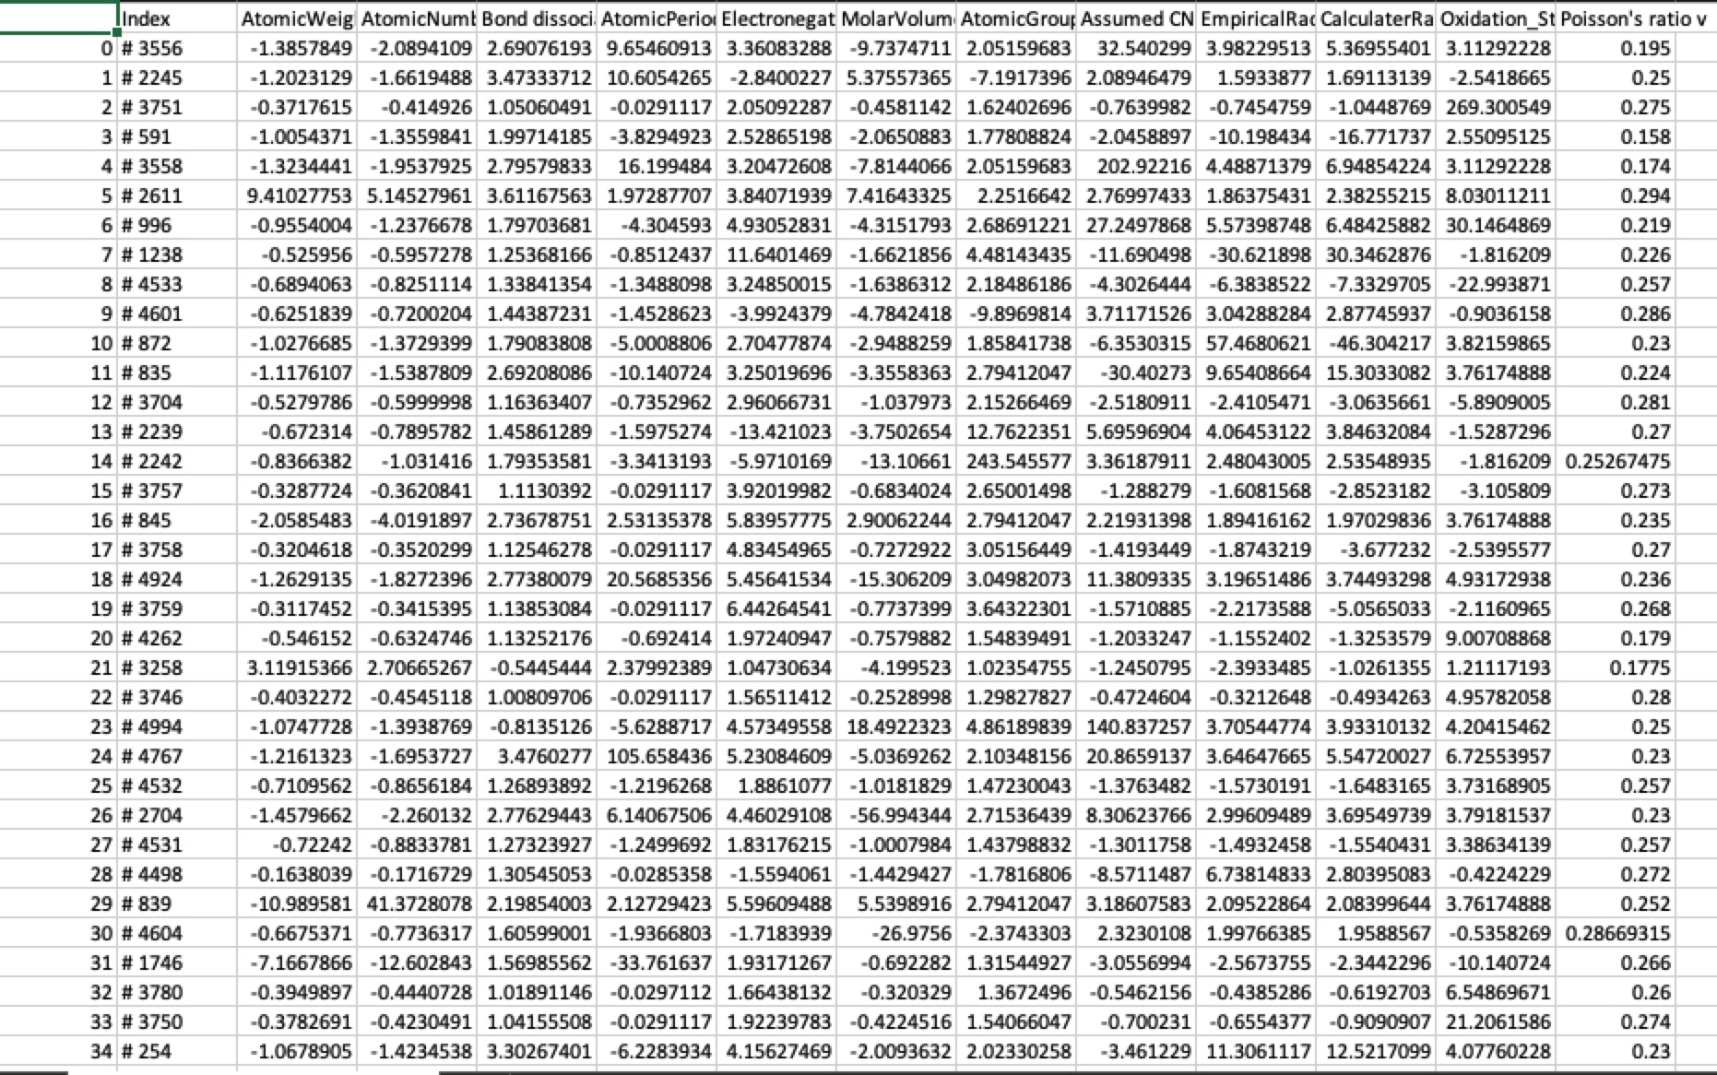
Archive of Features
Table of glass indices, selected features, and resulting value
(example for Poisson’s ratio)

Slide 6
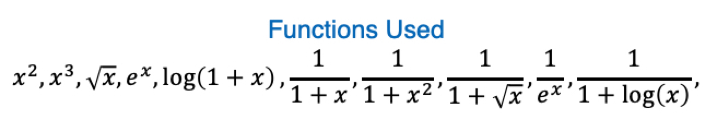
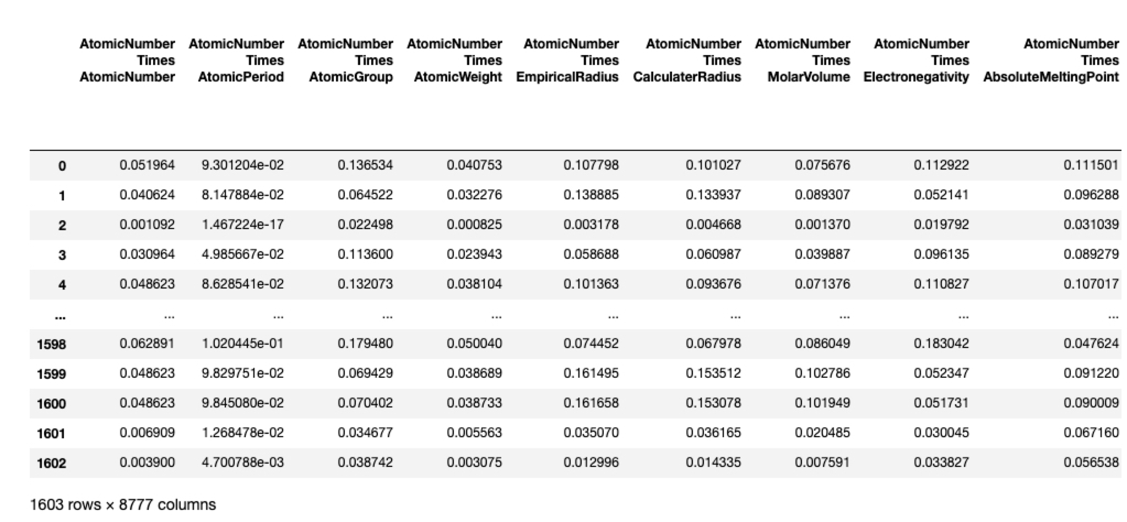
2nd Level Transformations
Multiplied feature columns together (filter out duplicate features)

Slide 7

Conclusion: Next Steps
List of transformations Used:
Further clean the 2nd level transformations
Train model using these new features
Compare results to 1st level transformations
Move on to potentially using PyTorch

